Slide 1
Game Analysis
By Kausar Ali
Mentorness Internship | 2024 | Batch Name: MIP-DA-06

Slide 2
Introduction
This presentation covers task two of the Mentorness Internship Program.
It focused on working with a dataset related to a game. The dataset includes two tables: Players Details” and “Level Details”
The aim is to answer 17 questions by writing SQL queries.

Slide 3
Problem Statement
-- 1) Players play a game divided into 3-levels (L0,L1 and L2)
-- 2) Each level has 3 difficulty levels (Low,Medium,High)
-- 3) At each level,players have to kill the opponents using guns/physical fight
-- 4) Each level has multiple stages at each difficulty level.
-- 5) A player can only play L1 using its system generated L1_code.
-- 6) Only players who have played Level1 can possibly play Level2
-- using its system generated L2_code.
-- 7) By default a player can play L0.
-- 8) Each player can login to the game using a Dev_ID.
-- 9) Players can earn extra lives at each stage in a level.

Slide 4
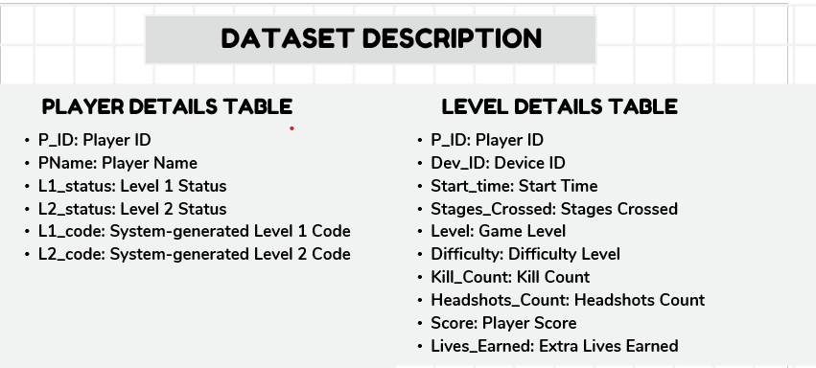

Slide 5
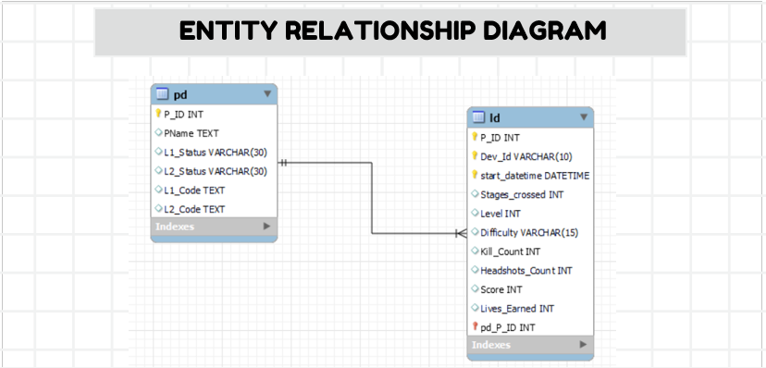

Slide 6
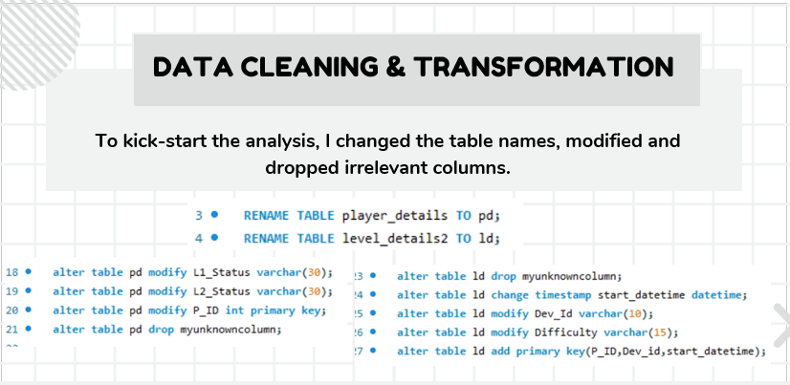

Slide 7
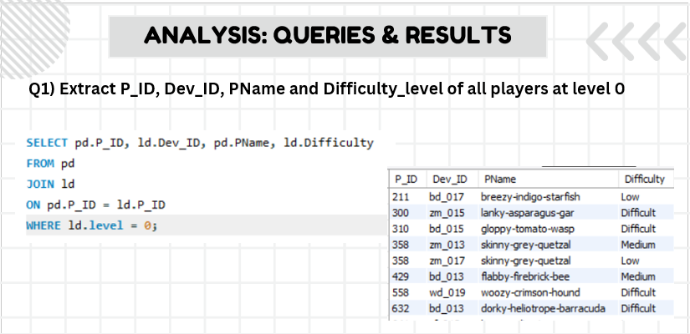

Slide 8
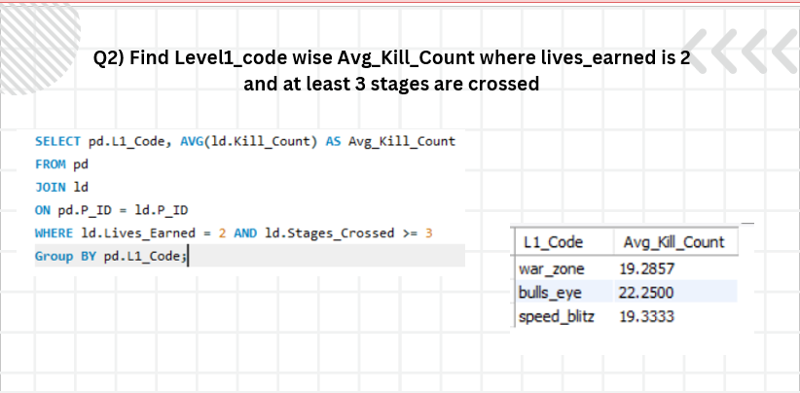

Slide 9
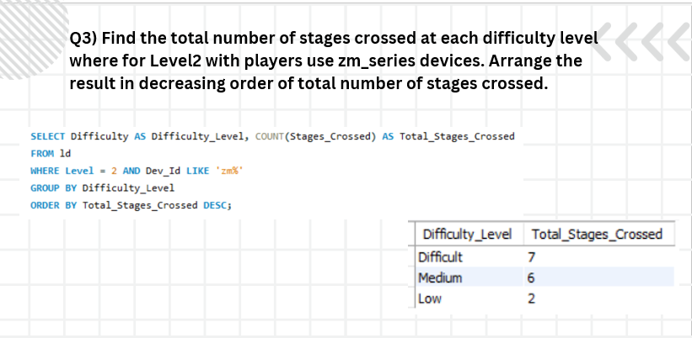

Slide 10
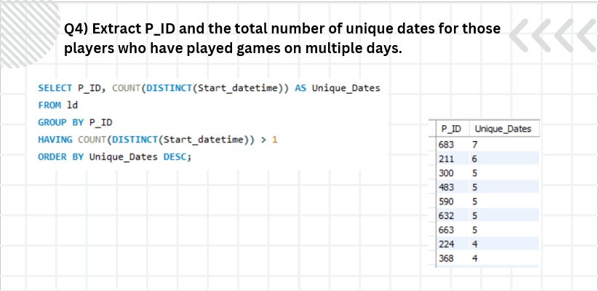

Slide 11
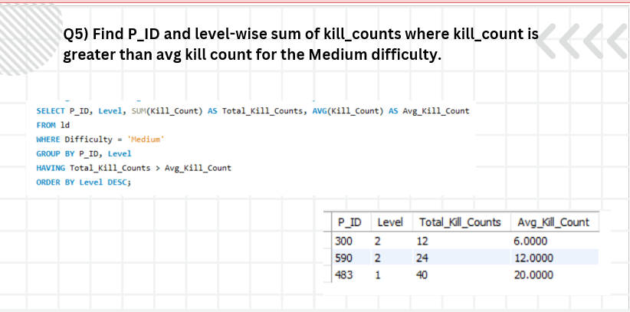

Slide 12
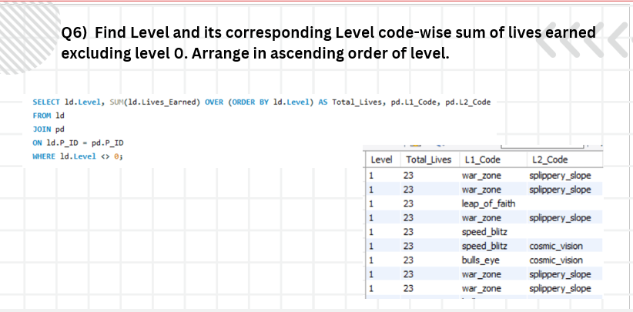

Slide 13
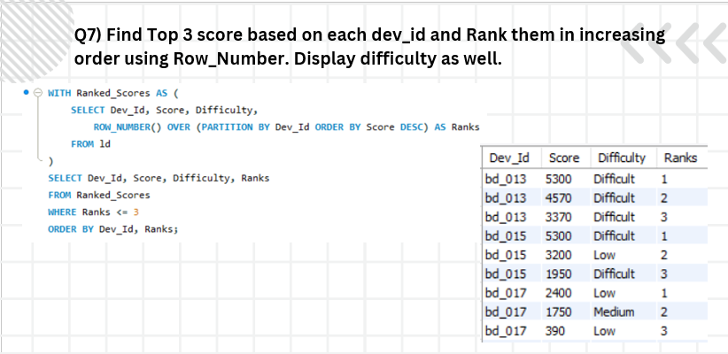

Slide 14
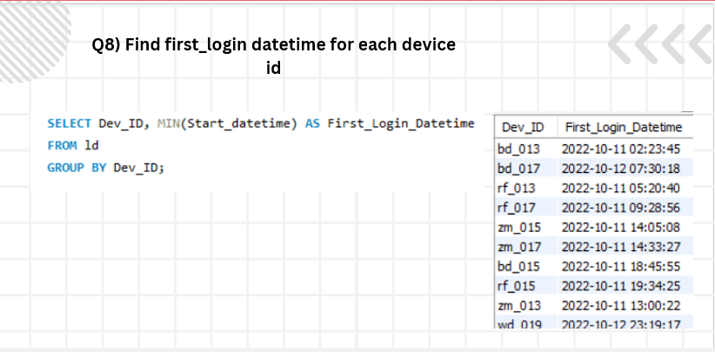

Slide 15
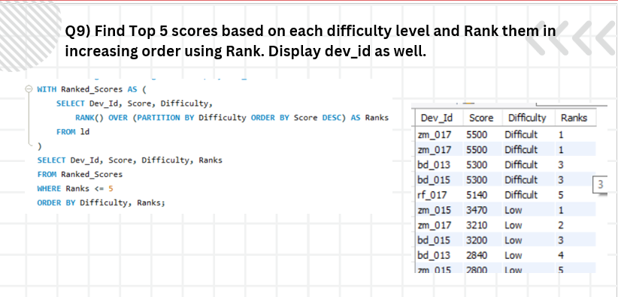

Slide 16
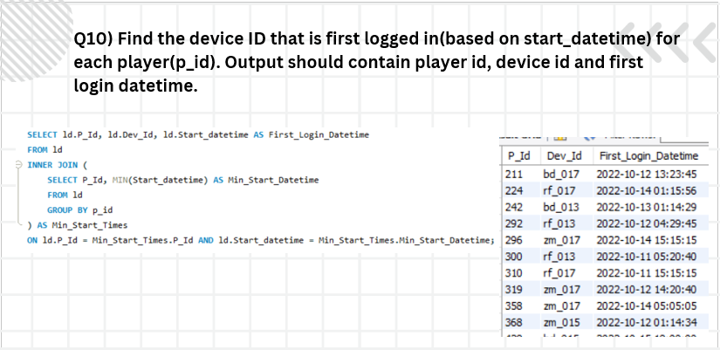

Slide 17
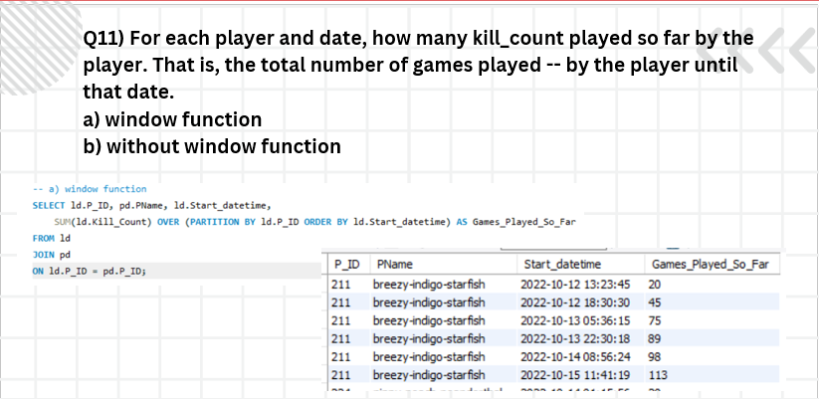

Slide 18
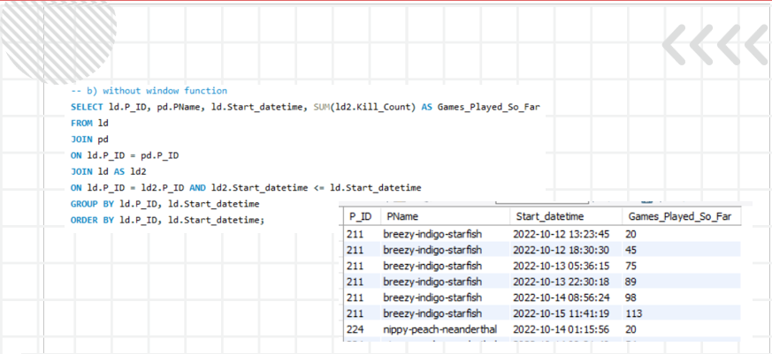

Slide 19
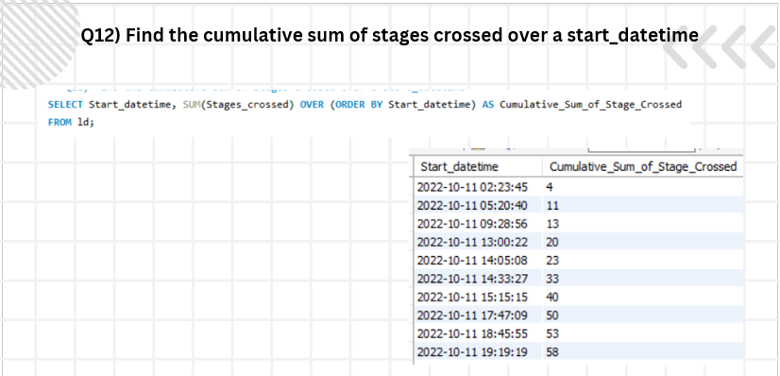

Slide 20
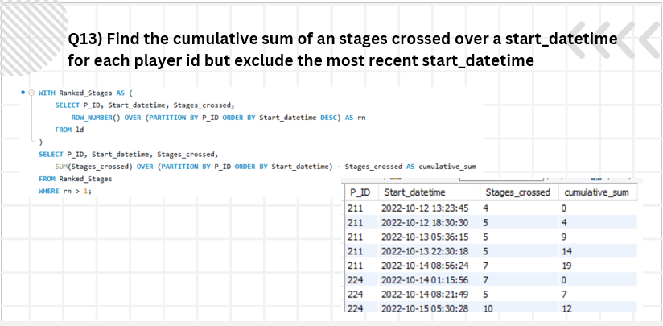

Slide 21
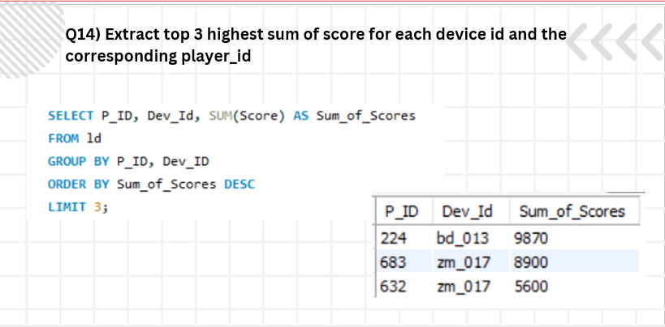

Slide 22
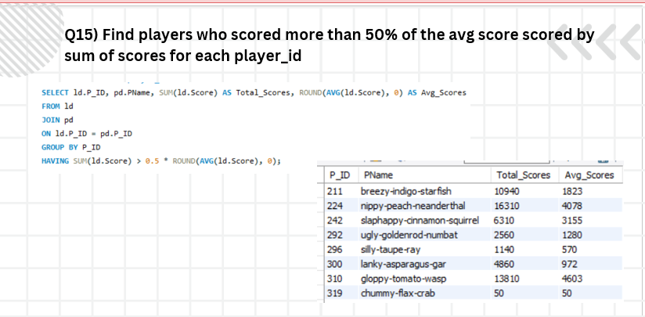

Slide 23
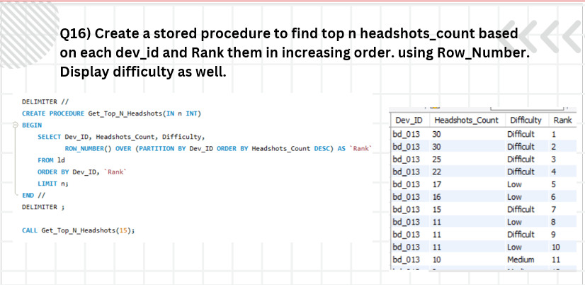

Slide 24
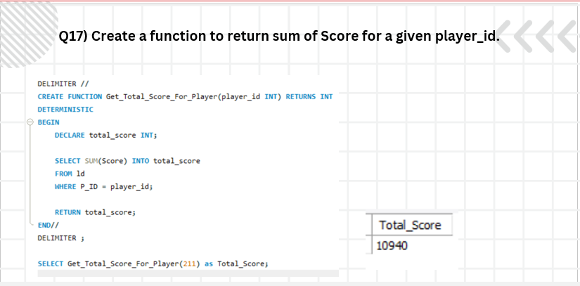

Slide 25
